Slide 1

Model exploration for classification
Artificial Intelligence
Alexander, Dennis, Hélène

Slide 2
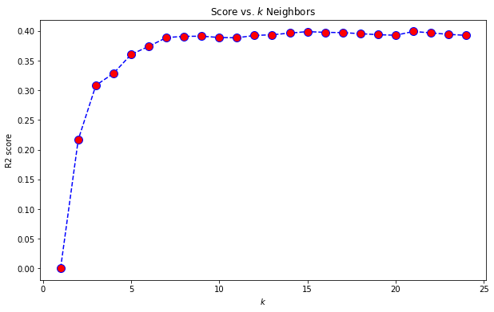
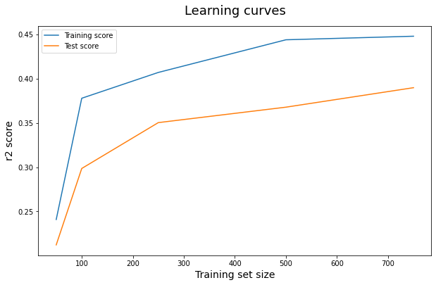

KNN
Variables used:

Slide 3
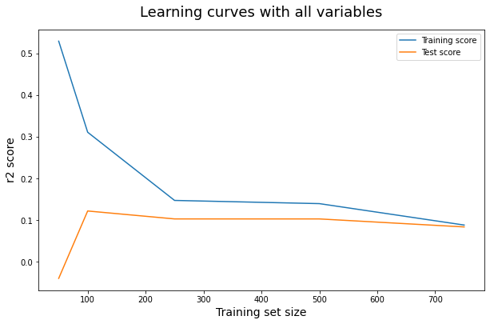
LDA
Variables used:

Slide 4
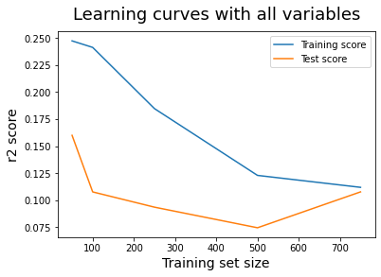

Logistic Regression
Variables used:

Slide 5
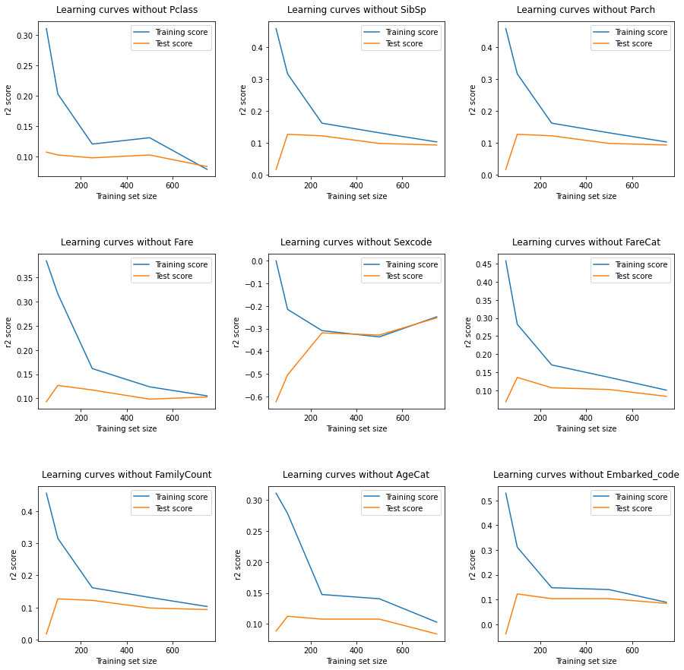
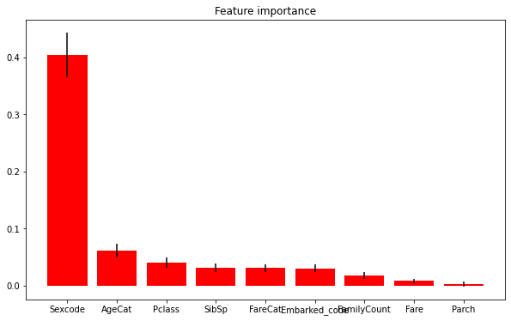
What are the most important variables to predict the outcome ?
Whether we compare “manually” or with permutation_importance from sklearn, it is clear that most decisive features are sex and age

Slide 6
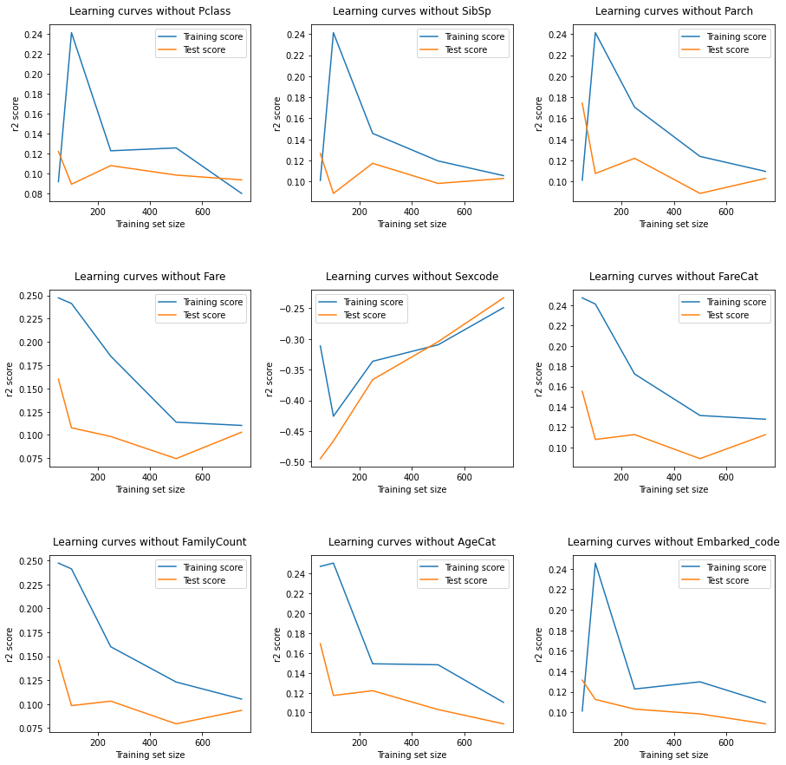
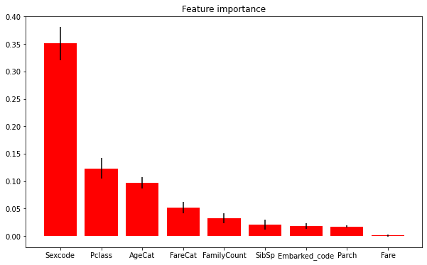
What are the most important variables to predict the outcome ?
Whether we compare “manually” or with permutation_importance from sklearn, it is clear that most decisive features are sex and class

Slide 7
What is the best model ?
Based on the comparison of R² or coefficient of determination:
Based on predictions on test data:
KNN LDA REG

Slide 8
What error rate can we expect on the test set ?
We can expect a higher error rate on the test set (because of over fitting)
The better the model, the lower the difference will be between error rate on train and test data

Slide 9
How to further improve our results ?
More data wrangling: create new features, find more clever ways of filling missing values
Try to use L1 or L2 regularization in the Logistic Model

